Slide 1
CELL COMMUNICATION
Slide show modified from a PREZI by David Knuffke

Slide 2
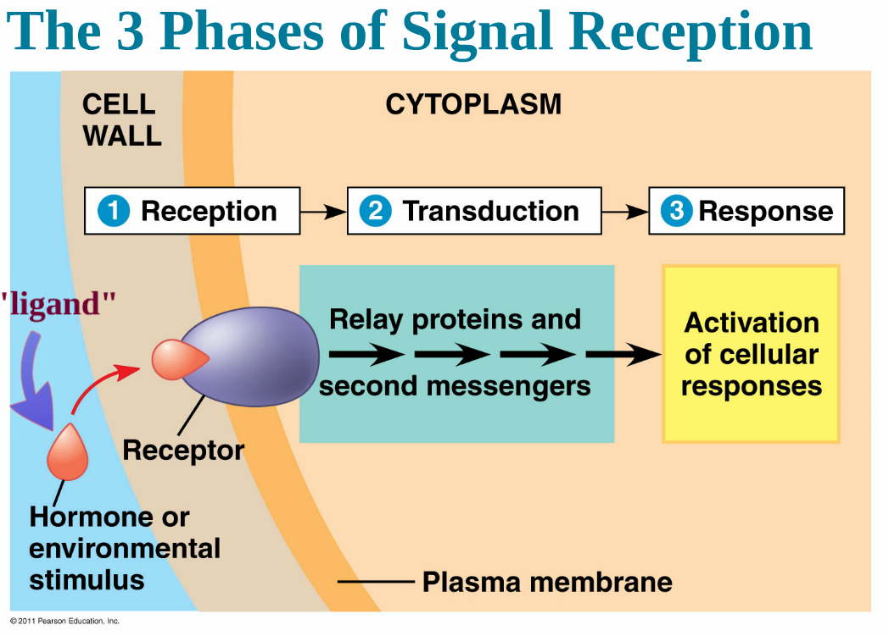

Slide 10
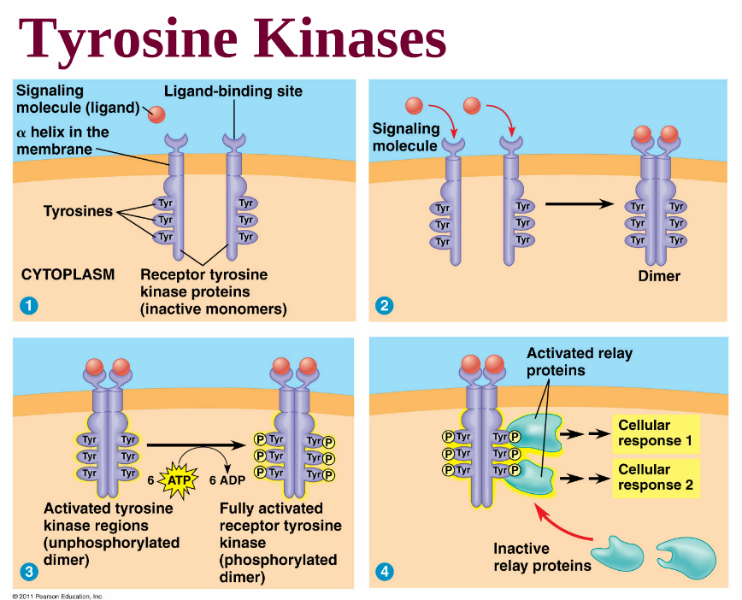
KINASE: Protein that “phosphorylates” (adds a phosphate to) another molecule
TYROSINE KINASES: Proteins that form dimers. Tyrosine amino acid residues are active in transfer of phosphates to relay proteins
Remain ACTIVE as long as LIGAND is attached

Slide 11
Incoming IONS trigger the response

Slide 12
Calcium ions are another common 2nd messenger

Slide 13
Internal signalling molecules released due to external “girst” signals. Trigger sub-response pathways

Slide 16
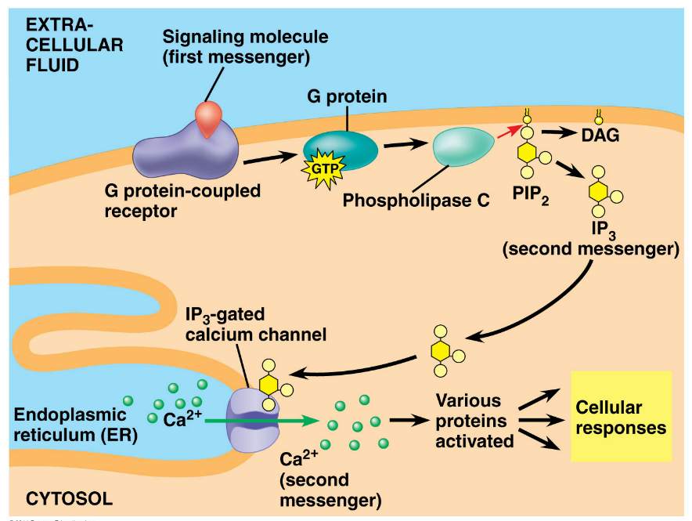

Slide 18
YOUTUBE Video

Slide 19
The L

Slide 20
AMPLIFICATION MORE FROM LESS
Cells amplify the message

Slide 22
COMPLICATION A “Branching Network”
S
Simplicity leads to COMPLEXITY

Slide 24
MORE EXAMPLES Why cells communicate?
Wound healing
QUORUM SENSING in bacteria communication among microbes that triggers group response when population reaches certain density
APOPTOSIS- Programmed cell death
Yeast mating

Slide 25
QUORUM SENSING

Slide 27
APOPTOSIS “Cell suicide”
Why are “Death proteins“ present in inactive form?

